Slide 1
Excel final assessment
Bertina S
Employee ID - 4270
Formula:
Steps involved:
Insights:

Slide 2
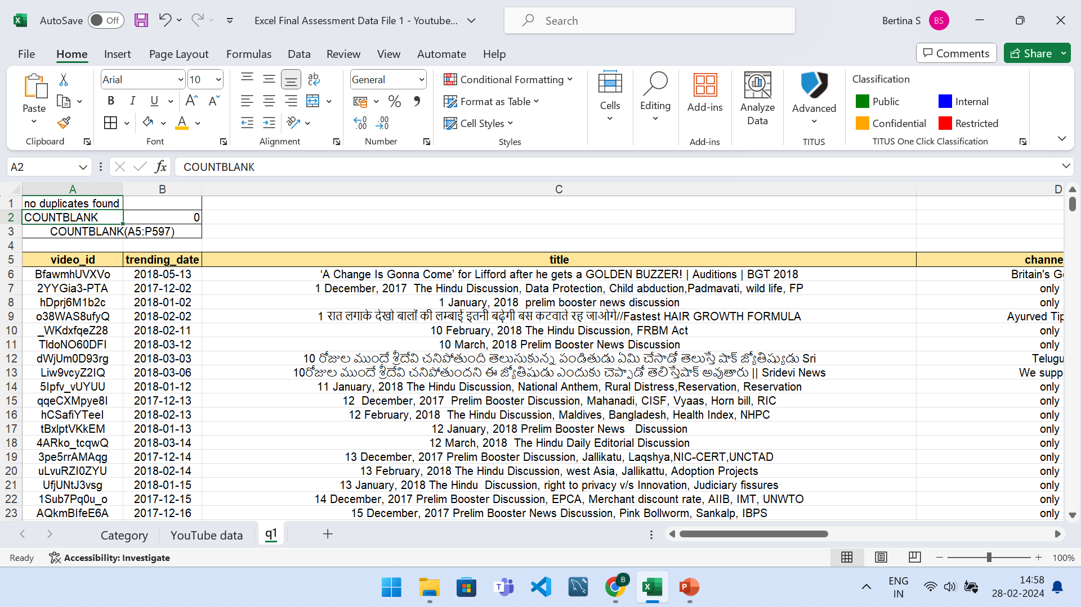
QUESTION 1
Formula: COUNTBLANK(A5:P597) Steps involved: Remove duplicate can be found in data > data tools > remove duplicate. To find out the cells which has missing data the above formula isblank() was used.
Insights: There was no duplicate or missing data.

Slide 3
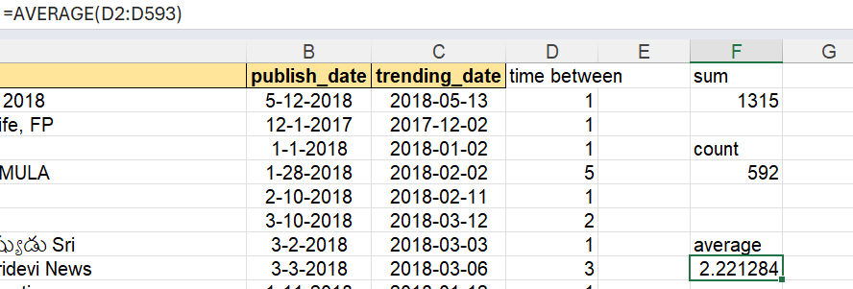
QUESTION 2
Formula: AVERAGE(D2:D593)
Steps involved: taking the average of the days in between publish date and it becoming trending will give us the average time gap which in this case is 2.22 days.
Insights: In average, for a video to become trending it takes a little over 2 days.

Slide 4
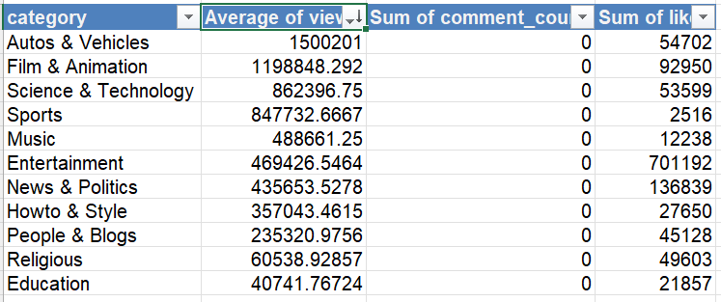
QUESTION 3
Formula: UNIQUE('YouTube data'!Q:Q) AVERAGEIF('YouTube data'!Q:Q,'q3'!A3,'YouTube data'!G:G)
Steps involved: Done with the help of pivot table.
Insights: The engagement rate is higher for film & animation in terms of likes and it is higher of autos & vehicles in terms of views.

Slide 5
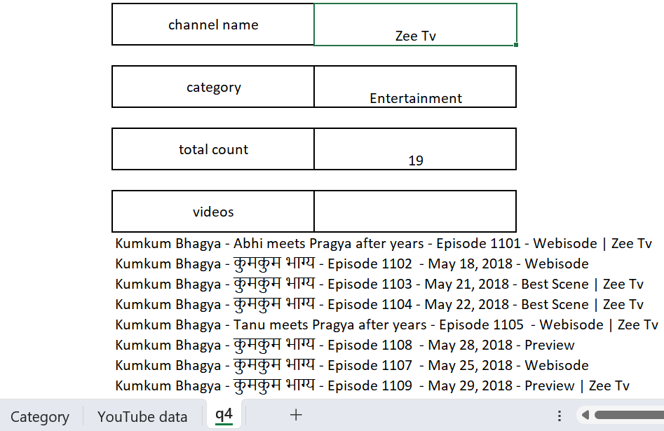
QUESTION 4
Formula: FILTER('YouTube data'!C:C,'YouTube data'!D:D=q4!I4),
XLOOKUP(XLOOKUP(I4,'YouTube data'!D:D,'YouTube data'!E:E),Category!A:A,Category!B:B)
Steps involved: using x lookup and filter we can make the excel sheet dynamic by the above formulas. X lookup is used the first time to match the category and the second time to find the category for the above mentioned channel name.
Insights: by making the excel sheet dynamic we are able to find the required categories very easily by just a few formulas.

Slide 6
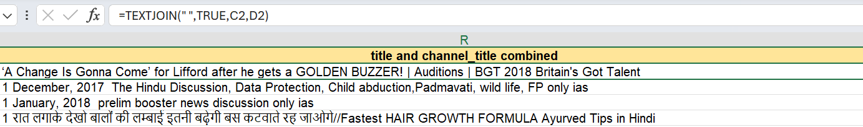
QUESTION 5
Formula: TEXTJOIN(" ",TRUE,C2,D2)
Steps involved: used textjoin to combine two columns – title and channel title.
Insights: We can now easily identify which videos belonged to which channel to find the trending videos faster.

Slide 7
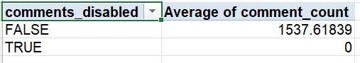
QUESTION 6
Formula: No formula, pivot table was used.
Steps involved: rows-> comments_disabled, values-> average of comment_count
Insights: comments were enabled for most videos. The average comment count is 1537. Comments were not disabled for any video.

Slide 8
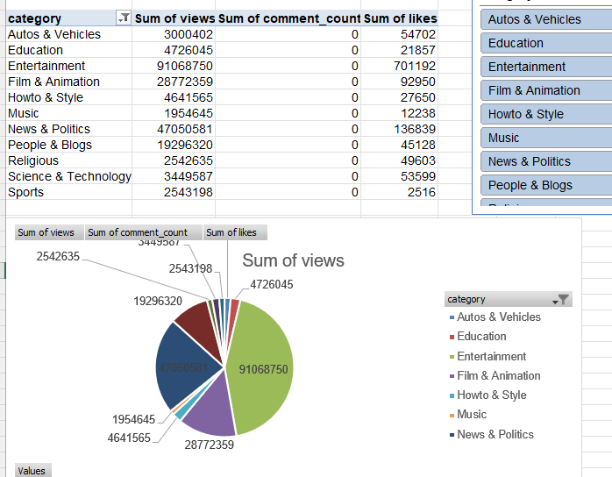
QUESTION 7
Formula: No formula involved. Pivot table was used.
Steps involved: create a pivot table, right click and insert bar chart, click on add labels. For the slicer, click on insert > filter > slicer. In case of multiple slicers, link them all by using report connections function.
Insights: Entertainment has the most amount of view.

Slide 9
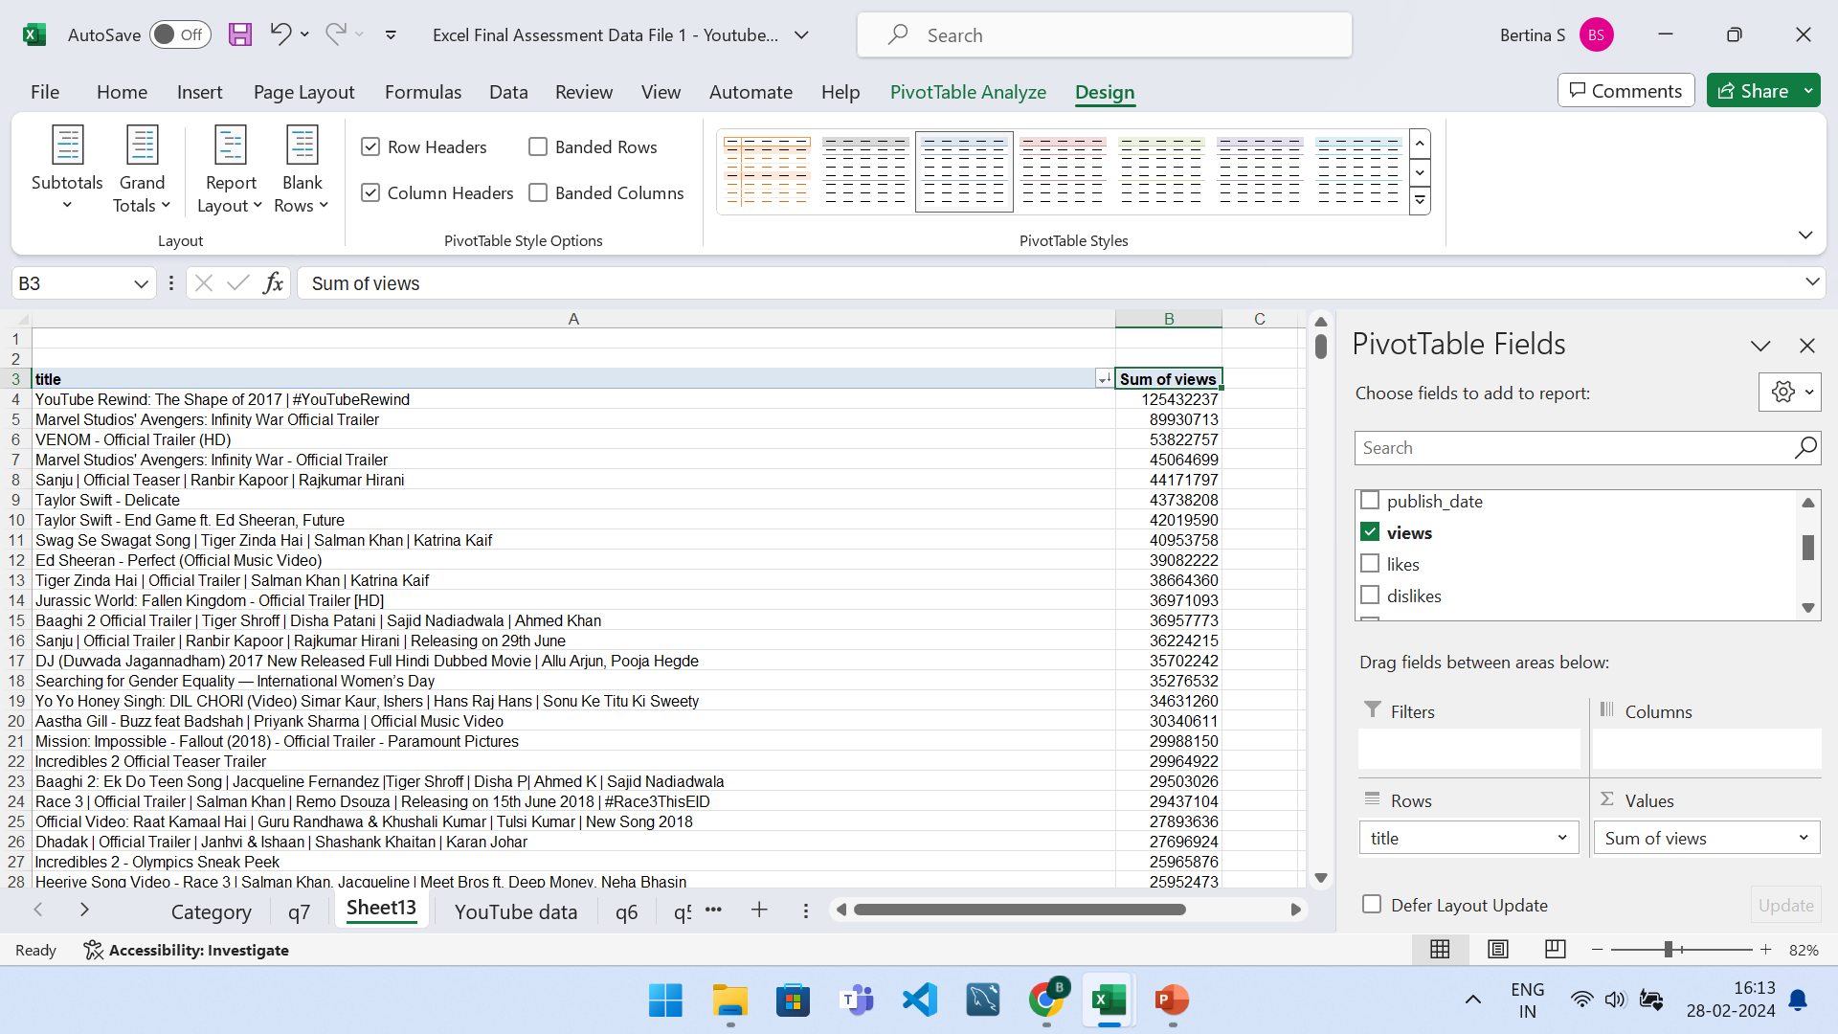
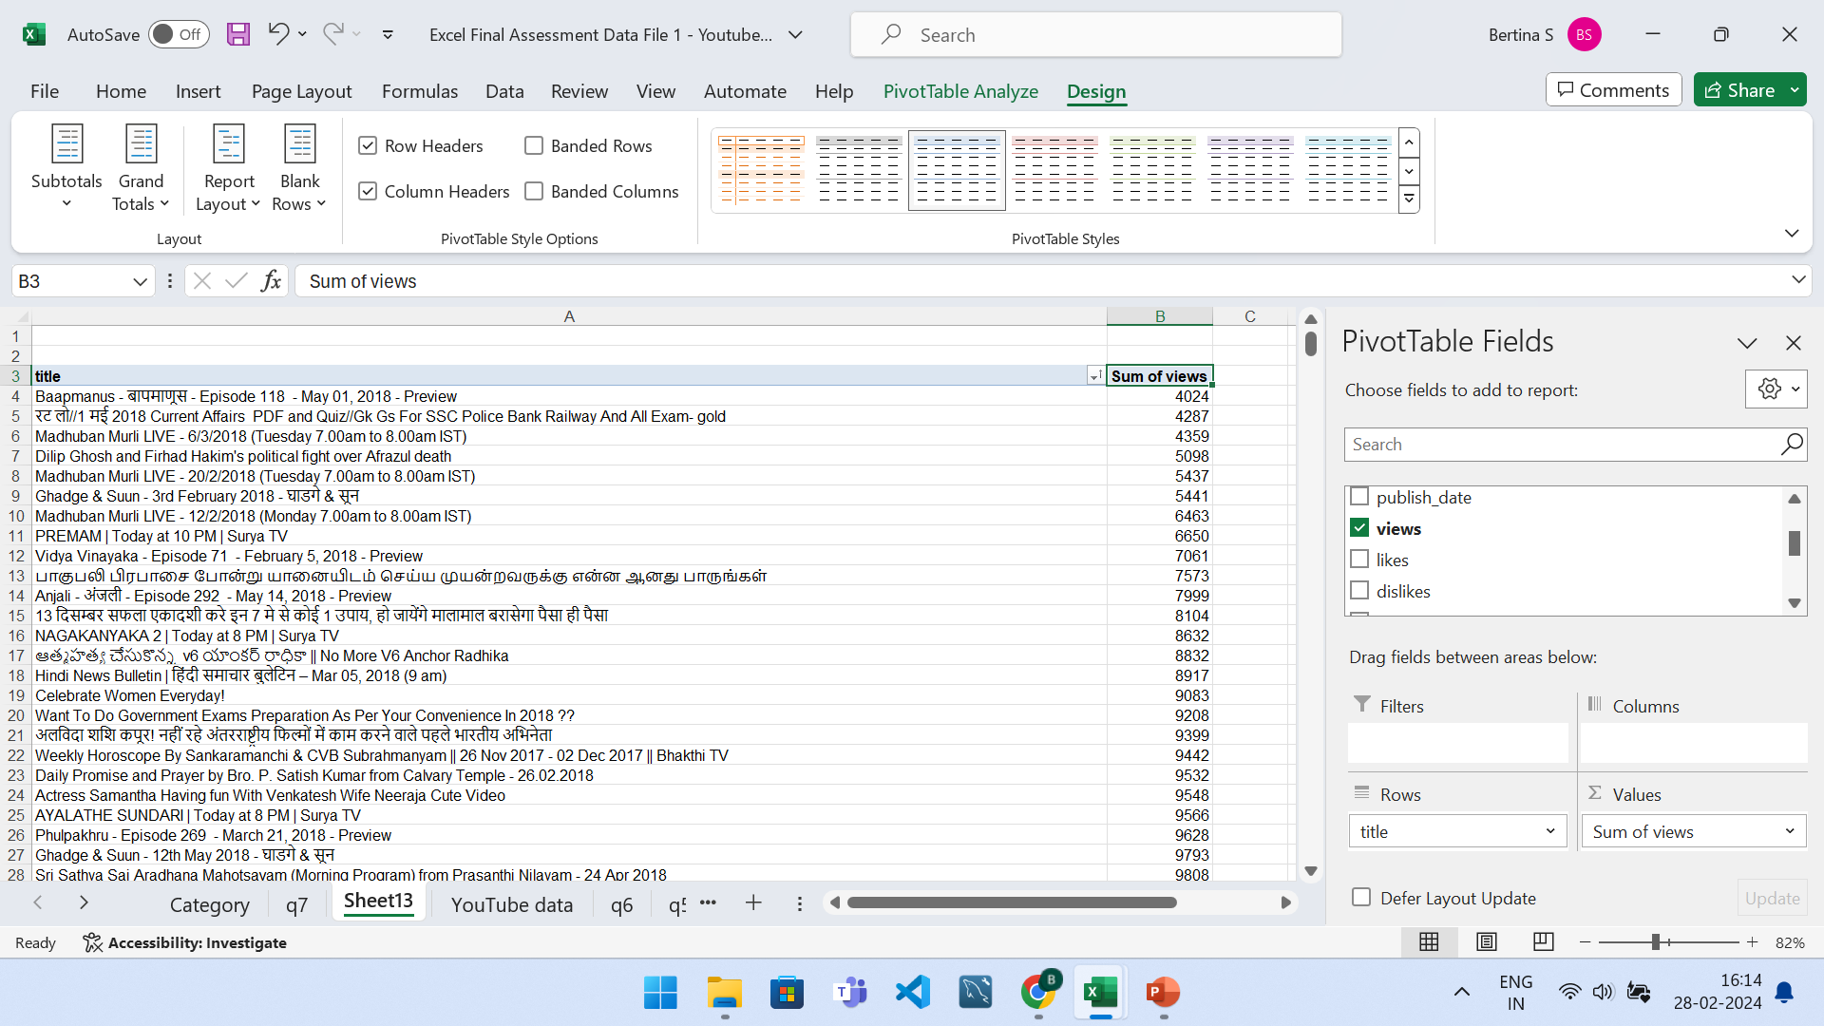
QUESTION 8
Top 5
Bottom 5
Formula: pivot table was used.
Steps involved: sorting was done in descending based on views for top 5 and sorting was done in ascending based on views for bottom 5.
Insights: There is a huge difference between the top 5 and bottom 5 videos based on views.

Slide 10
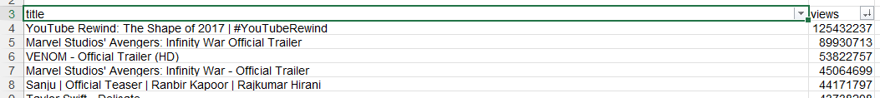
QUESTION 9
Formula: ctrl + shift + L was used to filter top 5 videos based on views.
Steps involved: filtering and then using top 5.
Insights: Youtube’s rewind was the most viewed.

Slide 11
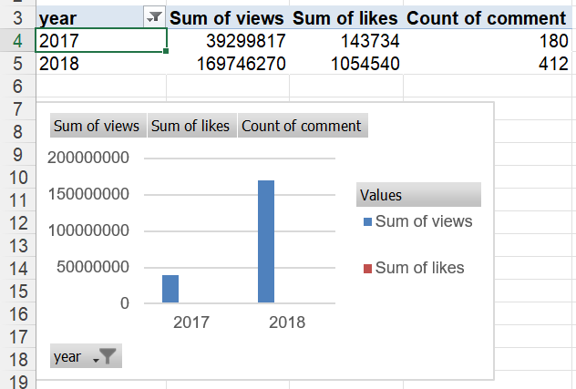
QUESTION 10
Formula: pivot table used.
Steps involved: grouping rows based on year and values -> views, likes and comments.
Insights: we can infer that the views, likes and comments have increased drastically in the year 2018 as compared with 2017.

Slide 12
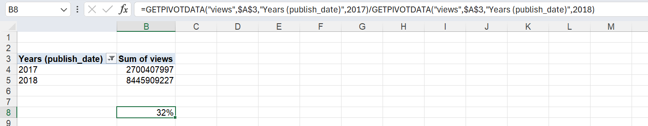
QUESTION 11
Formula: GETPIVOTDATA("views",$A$3,"Years (publish_date)",2017)/GETPIVOTDATA("views",$A$3,"Years (publish_date)",2018)
Steps involved: pivot table, sum of views of 2017/ sum of views of 2018 will give me the retention which is 32%.
Insights: Around 32 % of customer retention is found.

Slide 13
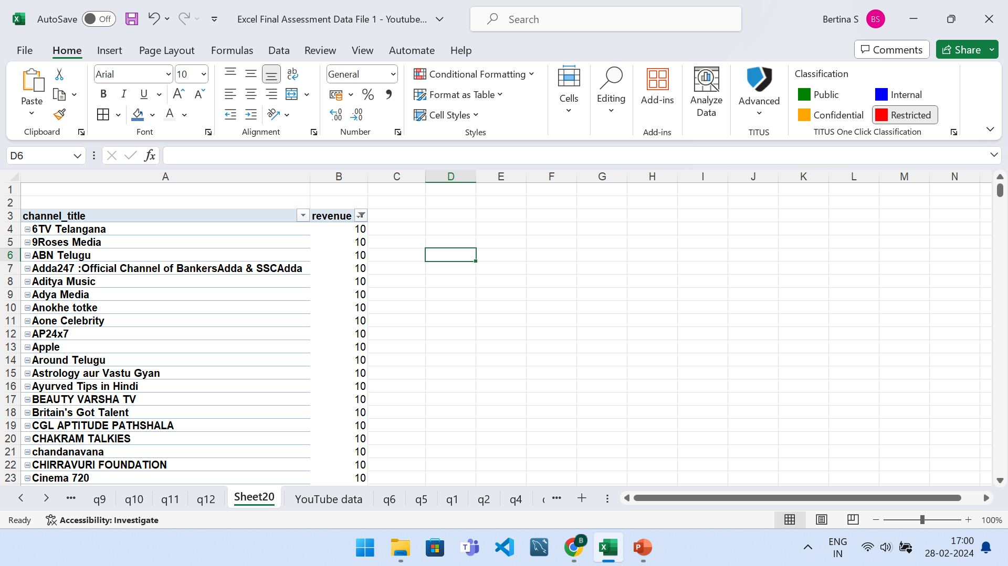
QUESTION 12
Formula: IFS(G7>=10000,10,G7>=100000,100,G7<10000,0)
Assumption : for revenue I’ve considered if views is less than 10000->0, greater than or equal to 10000 -> 10 and if it exceeds 100000 -> 100.
Steps involved: pivot table,
Insights:

Slide 14
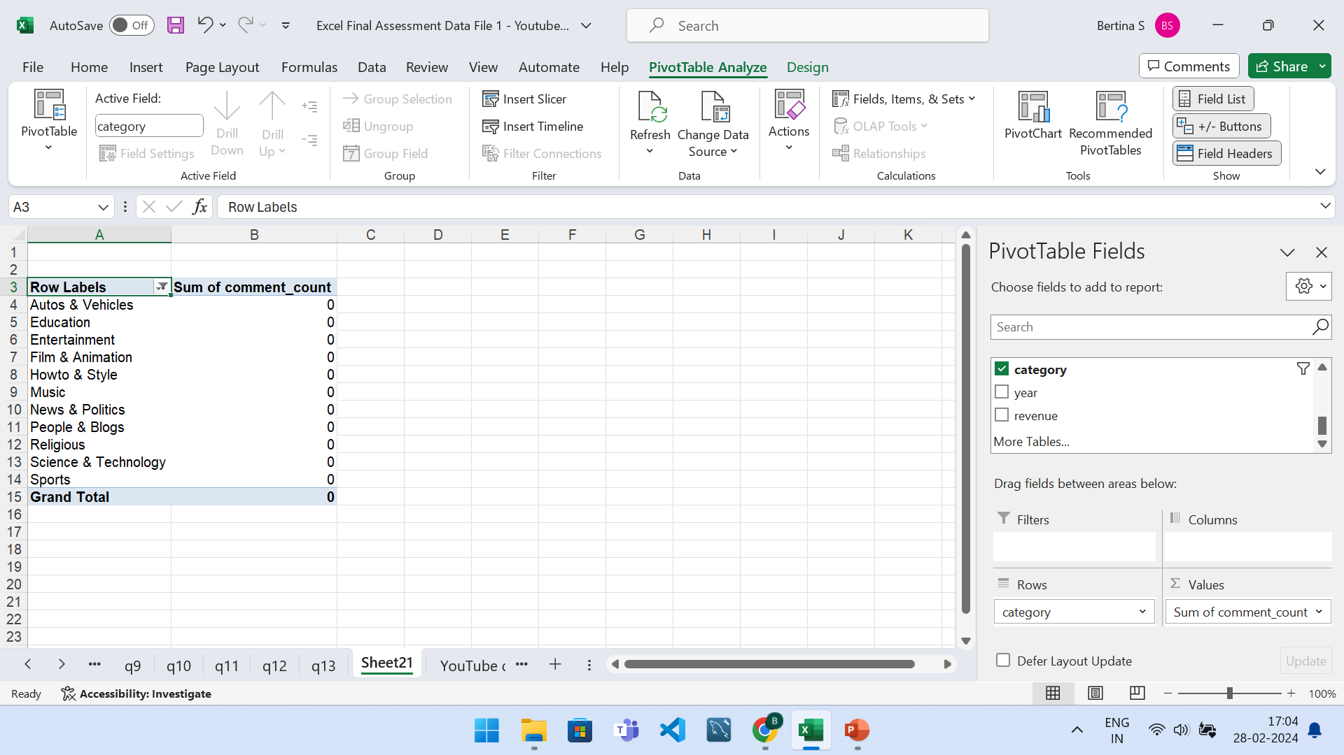
QUESTION 13
Formula: pivot table
Steps involved: rows are having the categories and comments are summed up on the values side.
Insights: comments summed up to be zero.

Slide 15
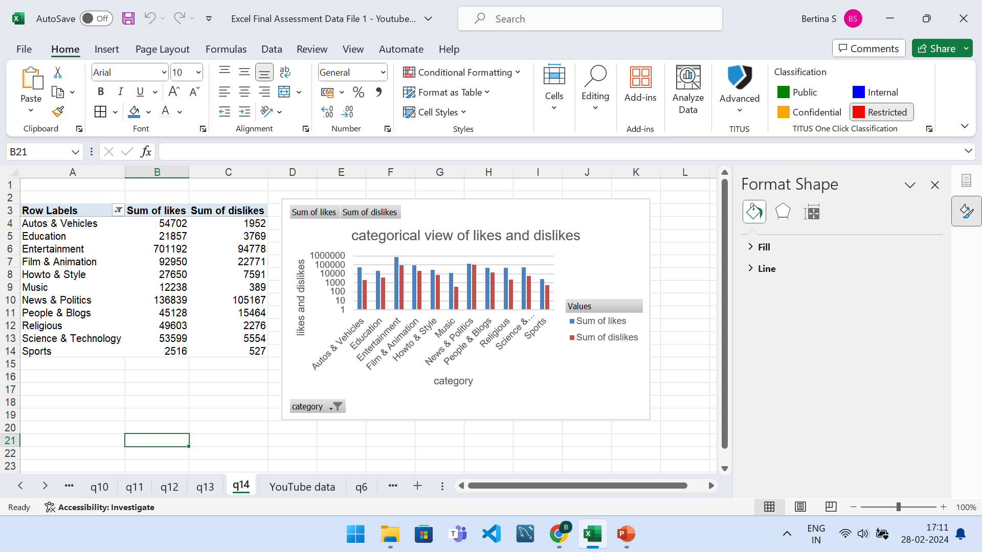
QUESTION 14
Formula: pivot table
Steps involved: row-> category, values -> sum of likes and dislikes. Click on log scale for better analysis.
Insights: the dislikes are very less as compared with the likes.

Slide 16
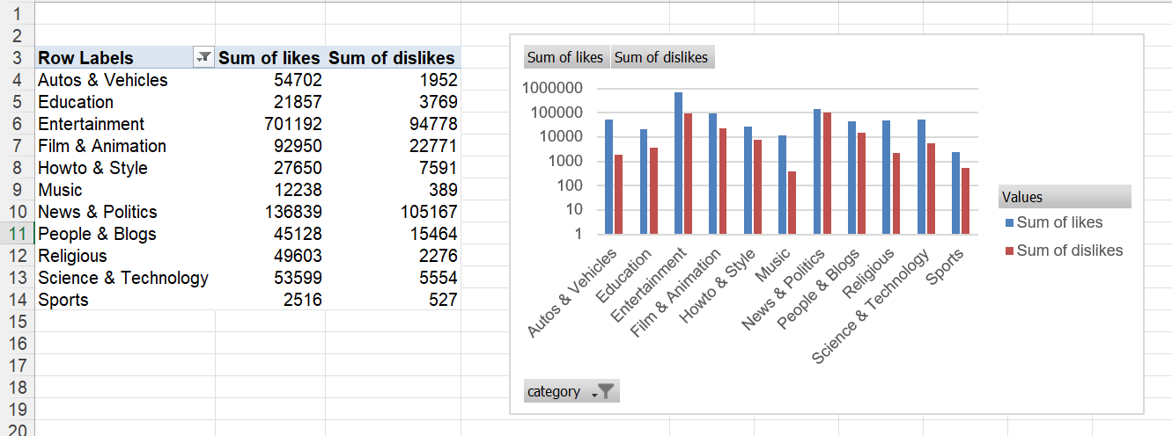
QUESTION 15
Formula: pivot table
Steps involved: row, likes, dislikes are dragged into the pivot table.
Insights: the number of dislikes are significantly less than the number of likes in each category.

Slide 17
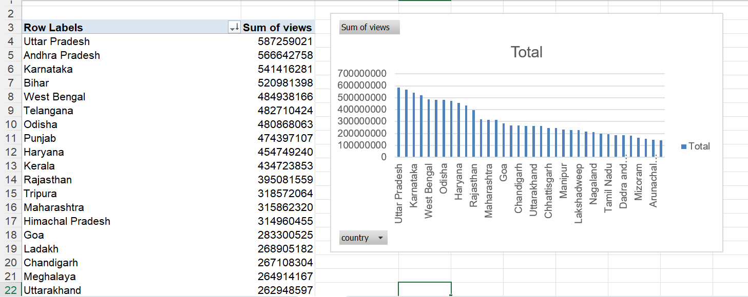
QUESTION 16
Insights: Uttar Pradesh has the highest views.

Slide 18
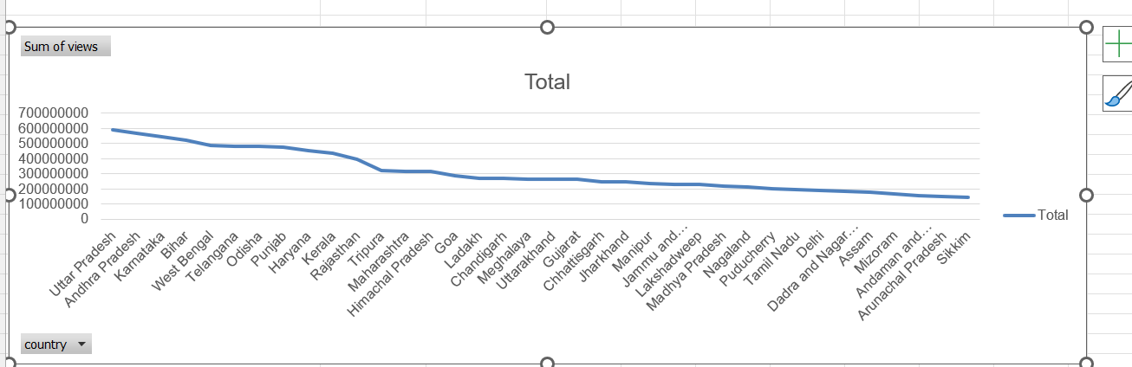
QUESTION 17
Insights: The outlier is Sikkim here. We can figure out the outliers by using the formula =skew()

Slide 19
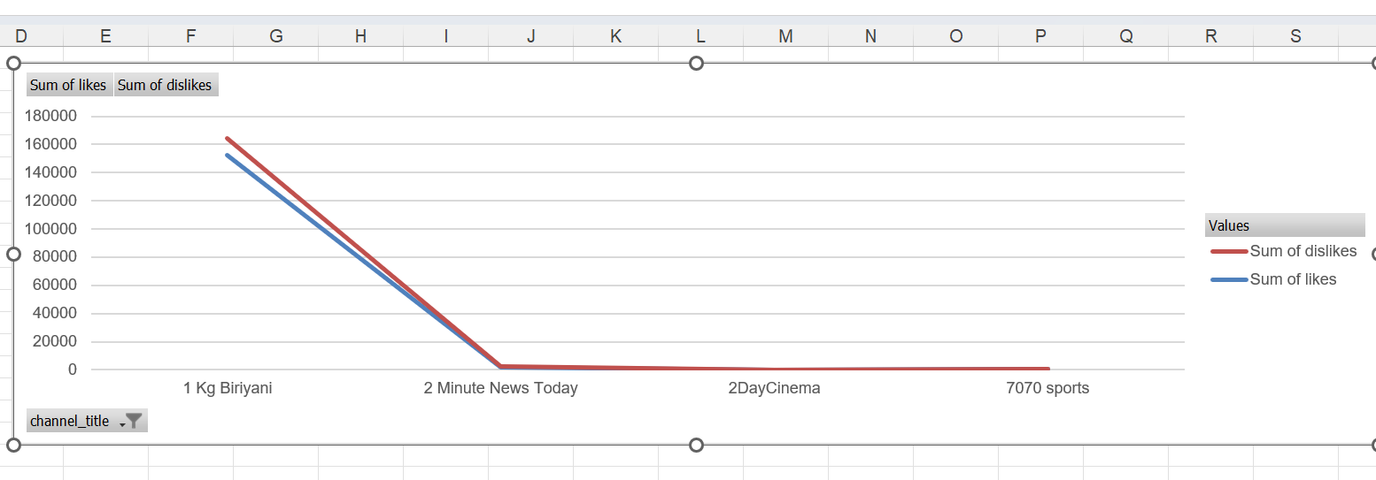
QUESTION 18
I’ve filtered the likes and dislikes for particular channels alone. The likes are more than the dislikes.

Slide 20
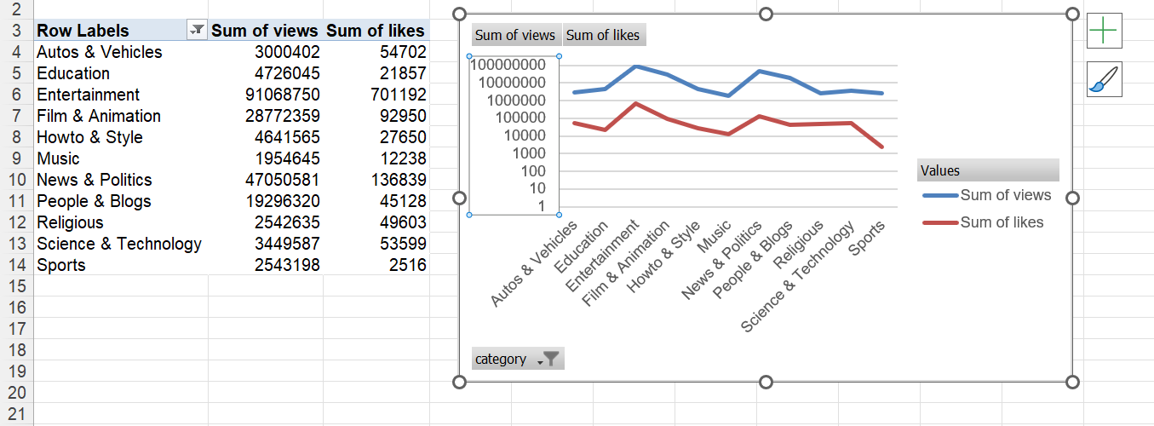
QUESTION 19
Insights: likes are significantly less than the views.

Slide 21
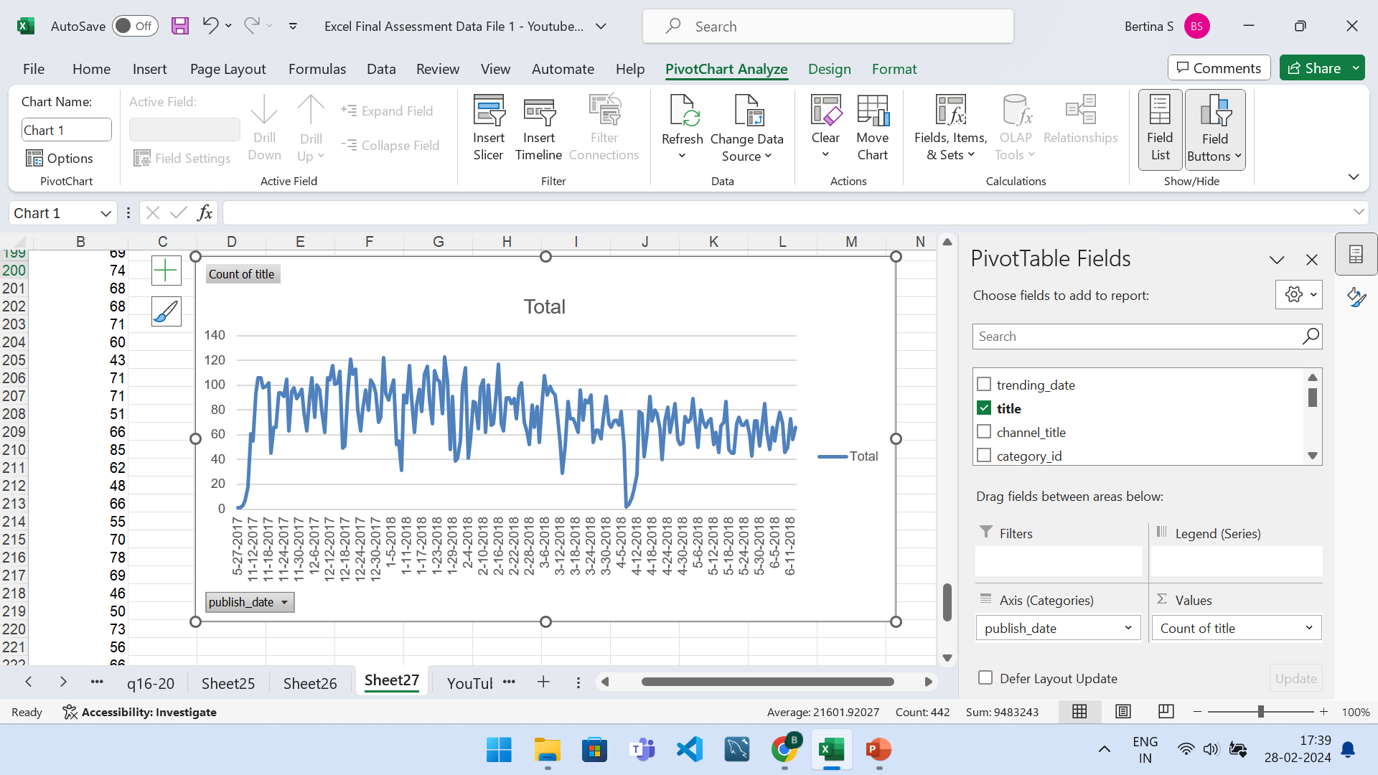
QUESTION 20
Insights: the retention rate is 32%
Formula: pivot table
Steps involved: insert > pivot table > drag and drop publish date in row and count in value

